Slide 1
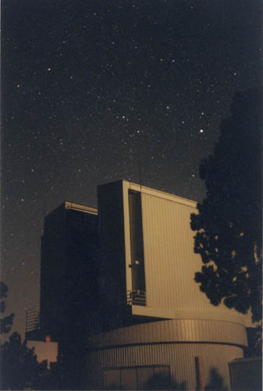
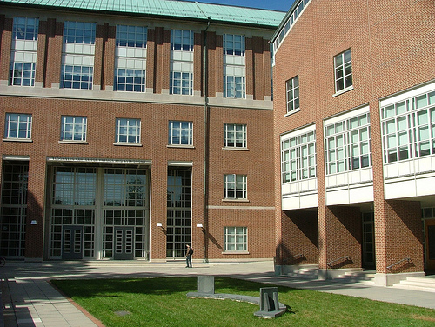
JHU: A Proud Member of ARC Since 1992

Slide 2
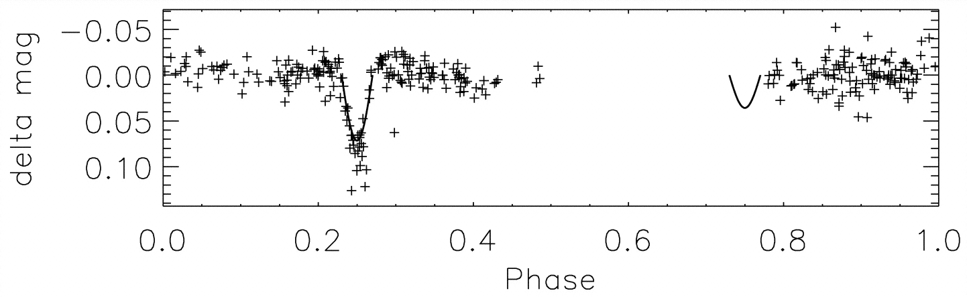
Science with the 3.5-m Telescope: Stellar Physics
Measurements of the masses and radii of the lowest mass stars
Leslie Hebb - PhD thesis (DIS)

Slide 3
Science with the 3.5-m Telescope: Galactic Structure
Kinematics and chemical compositions of metal-poor stars in the thick disk imply that they could not have come from disruption of a dwarf galaxy.
Greg Ruchti – PhD thesis
Echelle

Slide 4
Science with the 3.5-m Telescope:
Exo-Planets
A Neptune-sized exoplanet (blue) orbiting a binary star
Vaselin Kostov – PhD thesis (DIS)

Slide 5
Science with the 3.5-m Telescope:
Galaxy Evolution
HI-rich galaxies have steep declines in the metal abundance in their outer disk
Accretion event?
Sean Moran - DIS

Slide 6
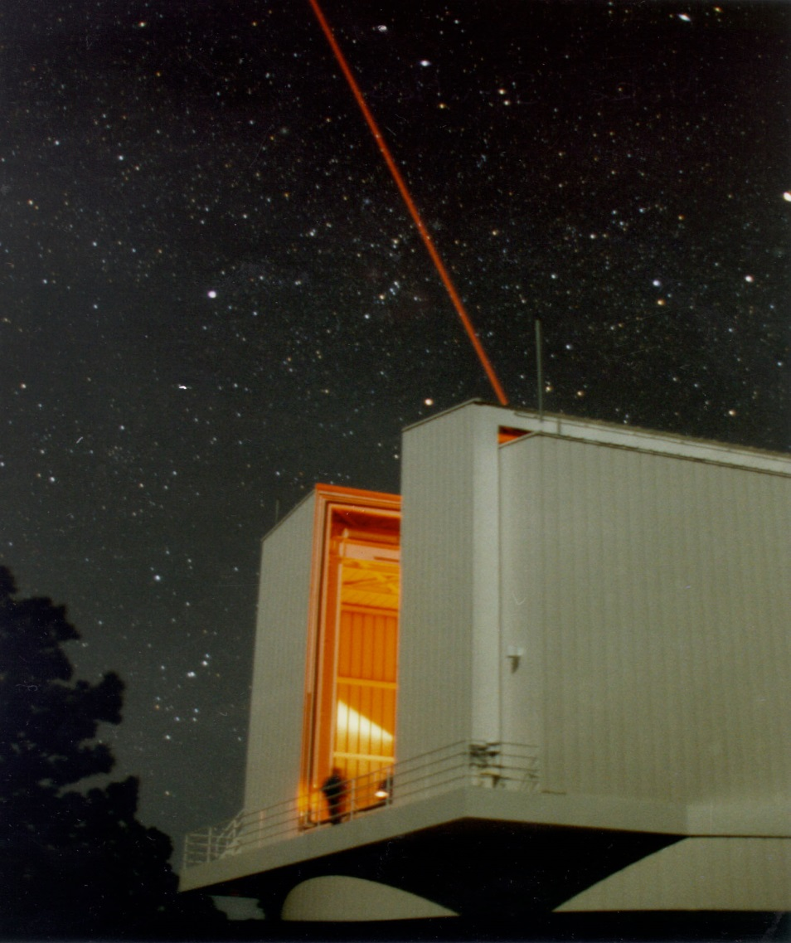

A toast to the 3.5m Telescope from your friends at JHU!

