Slide 1
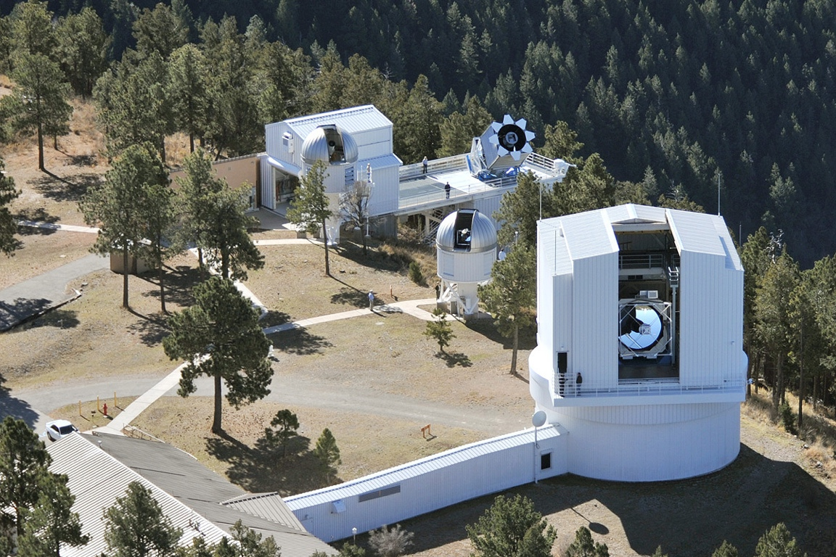
Apache Point Observatory
Latitude 32° 46' 49" N Longitude 105° 49' 13" W Elevation 9250 ft
The 2.5 Meter Sloan Telescope
The 0.5 Meter ARCSAT Telescope
The 1.0 Meter NMSU Telescope
The ARC 3.5 Meter Telescope

Slide 2
Apache Point Observatory Now and Then
May 2014 May 1994
4 Telescopes 4 Telescopes
(all operational) ( 1 operational)
1 Lab Building 1 Lab Building
3 Office Buildings 1 Office Building
1 Machine Shop/Garage 1 Shop/Garage
2 Dormitory Buildings (17 beds) 2 Dormitory Buildings (12 beds)
1 3 bedroom House Trailer 1 NSO house rental
10,000 sq ft storage rented

Slide 3
Apache Point Observatory Staff Now and Then (does not include ARC/SDSS institutional support)
May 2014 May 1994
3 Administration 2 Administration
2 Programming - IT 1 Programming -IT
6 Engineering 1 Engineering
4 Technicians 1 Observer
14 Observers (8 PhD’s ) 5 Total Staff
29 Total staff (includes SDSS)
29 Includes SDSS staff

Slide 4
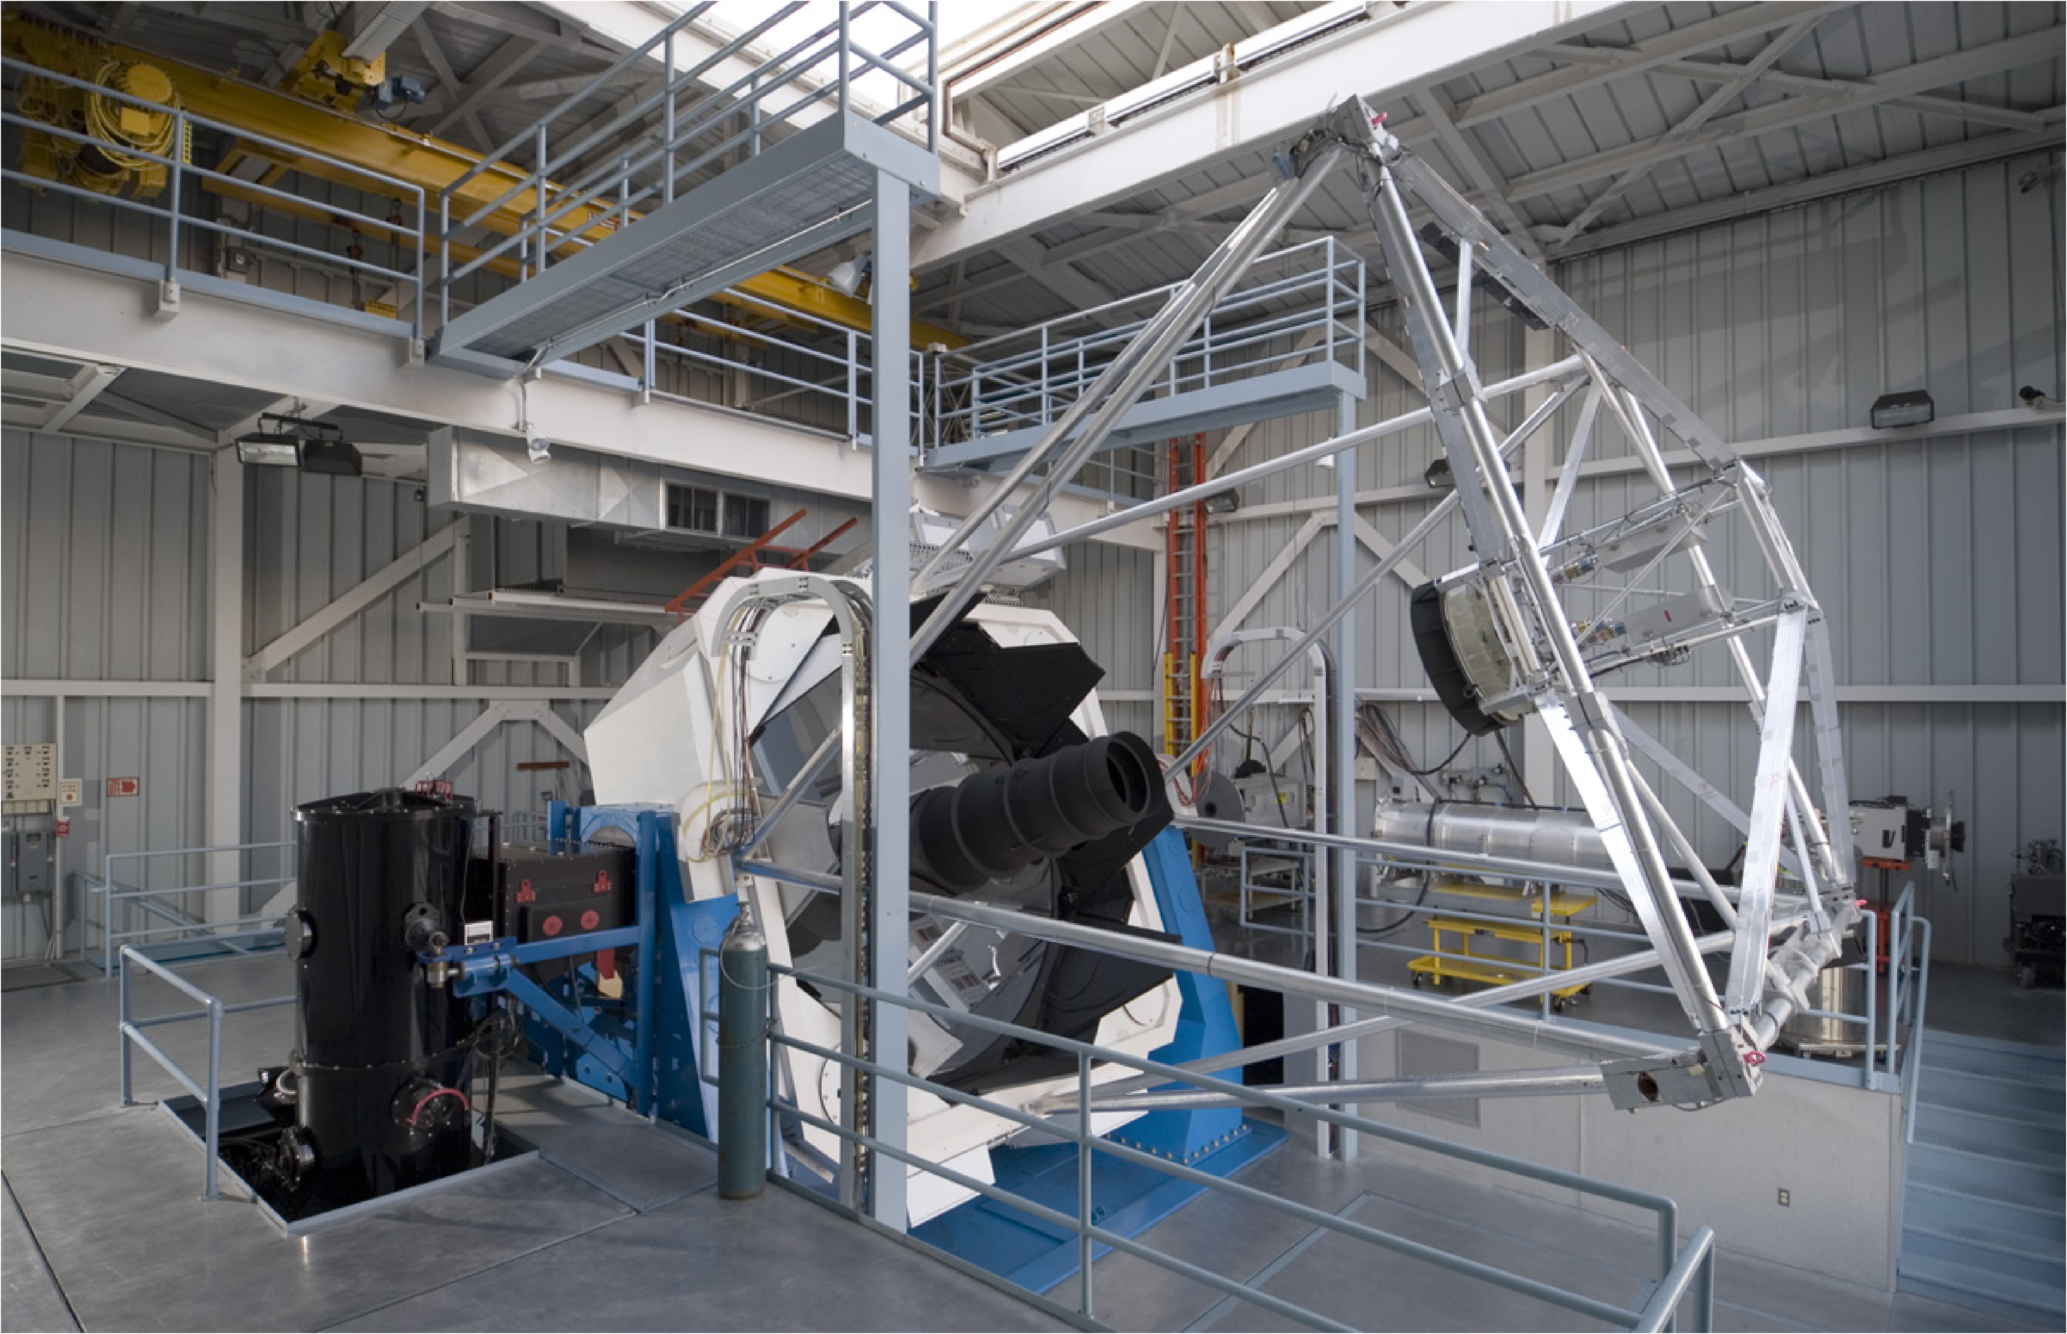
The ARC 3.5 Meter Telescope

Slide 5
ARC 3.5m Telescope Now and Then
Last Year (2013) First Year of Operation (94/95)
Observing hours
Scheduled : 4047 hours 2850 hours
Observed : 2796 hours 1585 hours
Equip loss : 29 hours 275 hours
Engineering : 310 hours 395 hours
Instrument Suite
DIS, ARCES, SPICam, NICFPS, Agile, TSpec, GIFS DSC, GRIM, DIS*
(ARCTIC in Development)
+ 4 guide cameras, wavefront sensor, engineering camera
and APOLLO

Slide 6
ARC 3.5m Telescope (2) Now and Then
Last Year (2013) First Year of Operation (94/95)
Image Quality
Visible : Median 1.1” Best 0.6” Median 1.7” Best 1.1”
NIR : Median 1.0” Best 0.5” Median 1.4” Best 0.9”
3.5m Staff
8.5 FTE + 1.5 external 7 FTEs + 2 external
Operations Budget (2014 Dollars)
$1,160,000 $656,707
($415 per Obs Hour) ($416 per Obs Hour)
Notes:
6

Slide 7
ARC 3.5m Telescope Staff
Mark Klaene – APO Site Manager Bill Ketzeback – 3.5m Chief Telescope Engineer Gretchen Van Doren – Program Manager Fritz Stauffer, Jon Brinkmann – Software Engineers Ed Leon – Electronics Technologist Ben Harris – Facilities Supervisor Russet McMillan – 3.5m Night Ops Mgr, Telescope Scheduler Jack Dembicky, Alaina Bradley, Alysha Shugart – Observing Specialists
Remote (at U. Washington)
Russell Owen, Conor Sayres – Software Engineers Nick MacDonald, Joe Huehnerhoff – Mechanical Engineers

Slide 8
ARC 3.5m Telescope Improvements
There have been numerous improvements and additions over the past two decades. See poster in back of room for details!
Major improvement projects
New Graphical Telescope User Interface (TUI)
Modern Axis Control System
New Direct Drive Motors on all axes
New Mirror Support, Control and Actuators
New Light Baffles
New Top End Assembly
New Telescope Control System software (in progress)

Slide 9
ARC 3.5m Instruments
Dual Imaging Spectrograph (DIS, Princeton, Jim Gunn)
ARC Echelle Spectrograph (ARCES, Chicago, Don York)
Optical Imaging Camera (SPICam, Washington, Chris Stubbs)
NIR Imaging Camera (NICFPS, Colorado, John Bally)
High Speed Imaging Camera (Agile, Washington, Anjum Mukadam)
Triplespec NIR Spectrograph (TSpec, Virginia, Mike Skrutskie)
Goddard Integral Field Spectrograph (GIFS, NASA/GSFC, Bruce Woodgate/Michael McElwain)
ARC Telescope Imaging Camera under development (ARCTIC, APO, Joe Huehnerhoff/Bill Ketzeback)

Slide 10
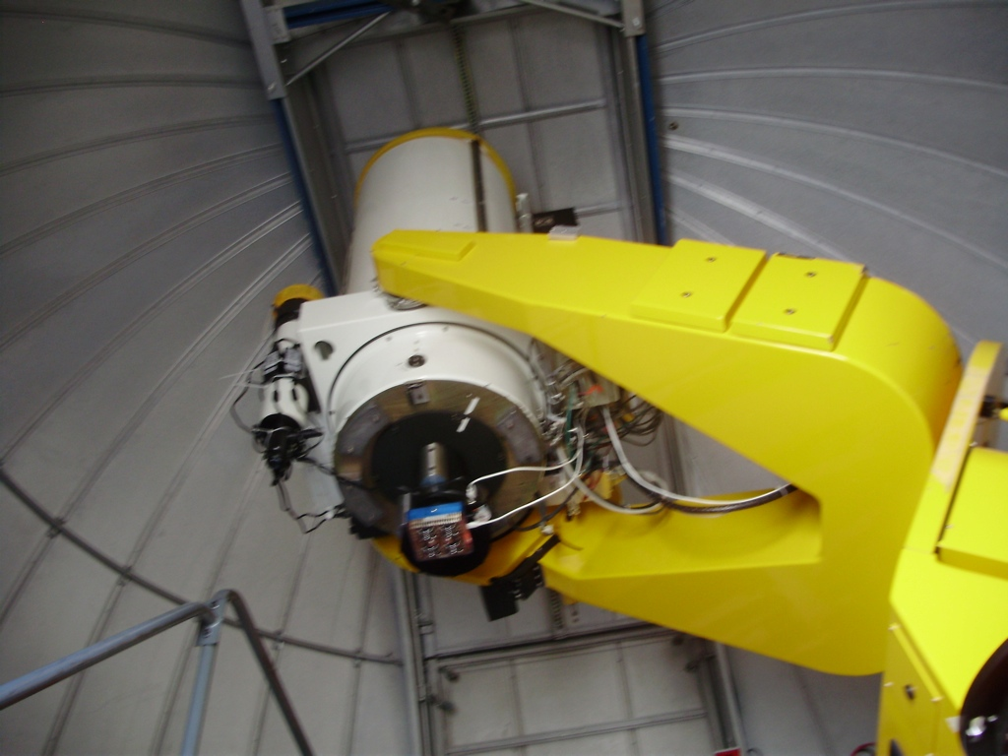
ARC Small Aperture Telescope (ARCSAT, 0.5m)
Originally from JHU for SDSS photometric calibrations
Upgrade project just completed, led by APO staff Joe Huehnerhoff and Bill Ketzeback.
Now in shared-risk operations with remote user interface, two imaging cameras
High interest and usage from ARC partners!

