Slide 1
APO and Diffuse Interstellar Bands 1982-2014 Donald G. York University of Chicago
APO 20th (30th ?) reunion
May 12, 2014

Slide 2
What are Diffuse Interstellar Bands?
570 interstellar lines between 4000A and 8500A (more to the red, developed by SDSS III IR spectrograph). Interstellar because they are stationary in spectra of spectroscopic binaries.
Known from first 2 discovered in 1919, for 95 years, unidentified by type of material or QM system in all that time.

Slide 3
Diffuse: widths >30 km/sec, compared to atomic line widths of 0.3 km/sec
Thought now to be molecular, species not agreed on.
If molecular, the diffuseness would be explained by radiative pumping of low lying rotational levels by the Cosmic Microwave Background (as for CN), but many more levels.

Slide 4
The personal story-- What APO means to me.
1. Thesis on Diffuse Interstellar Bands with Carnegie image tube of gain 0.1 and photographic plates. Tube was removed and thesis completed. Realized there had to be a better way. Dreams of having own large, private telescope to do long programs. I moved to Princeton to have such access (UV).
2. There is pre-history only known by rumor. (1970s)(NMSU, Washington, Howard).
3. Wallerstein talks to Jenkins (an ISM collaborator) at Princeton, Jenkins suggests Wallerstein talk to Ostriker.
4. JPO shows interest but cannot take on the full 1/3 partnership needed.

Slide 5
5. JPO asks me to be point person for Princeton and find out more. Travel to Sunspot, meets Anderson and Balick.
6. York uses Kitt Peak 4 meter (1980) to observe DIBs. CCD read noise, 50 electrons. Peer reviewed time highly restrictive.
7. John Lowrance, Princeton entrepreneur and engineer, suggests using remote observing using new technology (1400 baud modems) to control telescope from remote sites. Princeton did that with Stratoscope in the 1960s.

Slide 6
8. York moves in 1982 to Chicago, informs colleagues of possibility.
9. Dean Stuart Rice urges astronomers to be more ambitious and go for the partnership.
10. Consortium formed. Washington, Washington State, NMSU, Princeton, Chicago. 1983. Roads started
11. Around 1988, instruments were decided, including an echelle (NSF proposal).
12. 8 years of waiting, for mirror, instruments, etc.
Remote operation worked almost out of the box, by 1988, in trial runs.

Slide 7
Echelle on telescope with SDSS-SITE 2kx2K CCD, 5 electron read noise. Mirror from Arizona, Lots of organizing and engineering.
January 7, 1999, first DIB spectra taken,
15 Mon and rho Leo. Signal to noise 500 in single spectra. The dream had come true. Technology, private telescope, lots of time, remote observing
Since then, we have observed over 200 half- nights, over 300 stars

Slide 8
Co authors:
Julie Dahlstrom (Carthage)
Dan Welty, Tak Oka, Lew Hobbs, Reid Sherman, Sean Johnson, Zihao Jiang (Chicago)
Scott Friedman, Paule Sonnentrucker (STScI)
Brian Rachford (Embry-Riddle Aeronautical University).
Ted Snow (University of Colorado)
arXiv:1305.3003

Slide 9
Two reddened stars, S/N 3000
Interstellar neutral sodium
Beta Ori
*
HD 183143
10 Lac
* * (
HD204827
DIB 5780, 5797
5700A
5900A

Slide 10
Two reddened stars, 54 DIBs in 200A
Vertical Ticks:
Red: HD 183143
Green: HD 204827
Black: Common DIBs

Slide 11
The key to identification lies in laboratory matching of spectra. (This has been tried since the time of Herzberg with no success.)
Observations of DIB profiles. This is what we can do.
Two stories: a unique star in a nebula
And the recent Supernova 2014J in M82

Slide 12
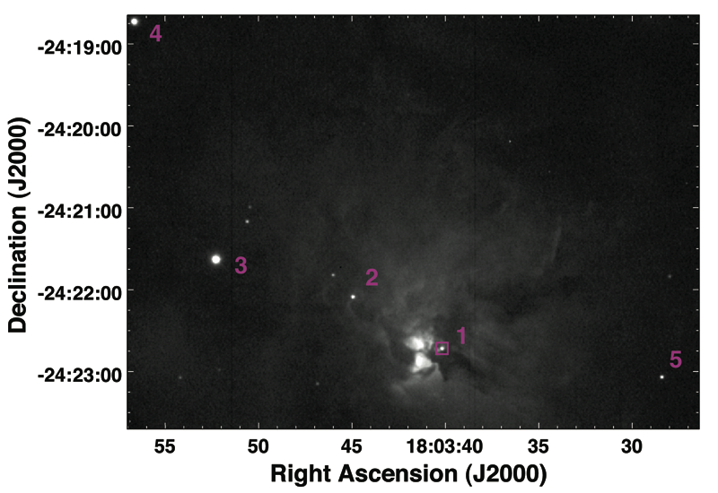
Herschel 36 in NGC 6530

Slide 13
Herschel 36 in NGC 6530, Dumbell Nebula, 33 APO spectra
over 13 years.
*

Slide 14
Isolating the anomalous DIB
Profiles to within 0.5 pc of
Her 36
Distance from Her 36
1000 pc
10 pc
0.5 pc
Herschel 36
IR pumping of
J = 1 level of CH+
(not known anyplace else In ISM)

Slide 16
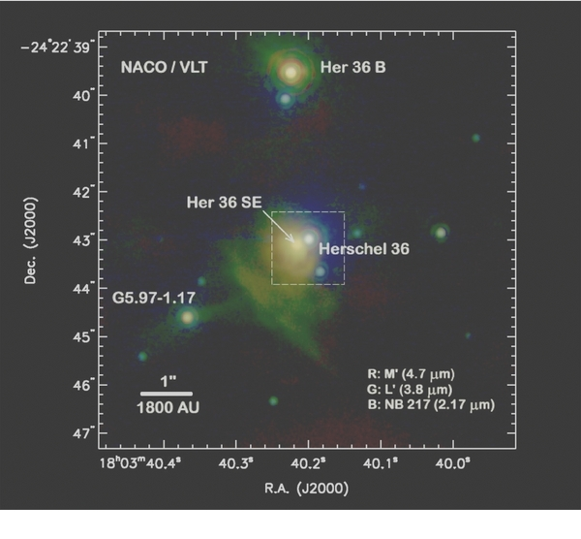
Herschel 36SE, 400 pc from Herschel 36, the infrared
source that pumps rotational levels of CH+ and DIBs

Slide 17
Supernova 2014J, M82, DIB profiles, stack of 47 spectra, 15 hours
LSR velocity, km/sec
LSR velocity, km/sec
-100
0
+100
_+200
+300
-200
0
200
400

Slide 18
Individual line profiles
For SN2014J
Welty (Chicago)
Ritchey (UW)
Dahlstrom (Carthage)
York (Chicago)
Black trace—data
Red trace—DIB proportional to K I
Green trace– x 7 weighting for DIB in K I components.

Slide 20
FIN

