Slide 1
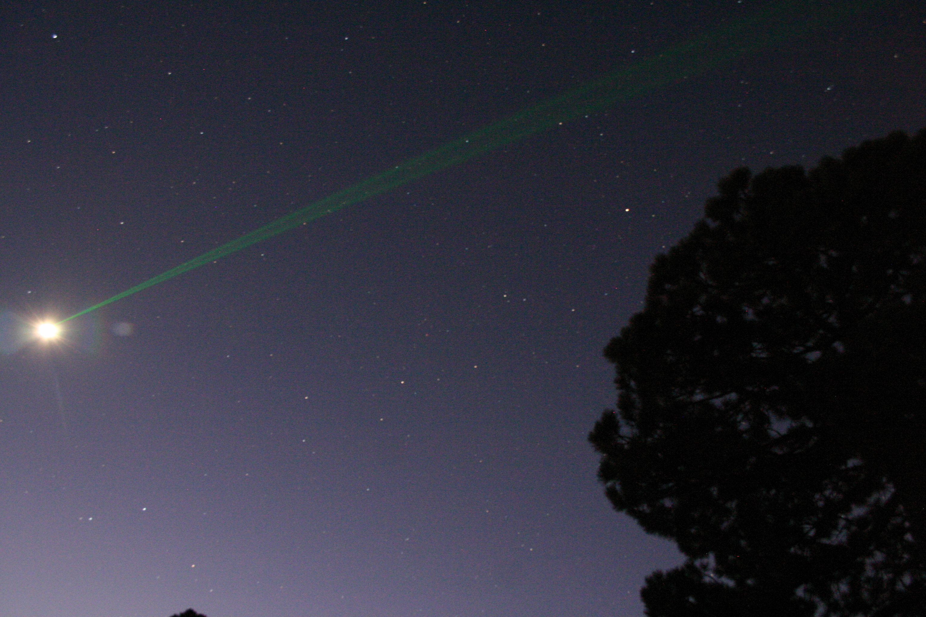
APOLLO
Lunar Laser Ranging as a
Test of Einstein’s General Relativity
(do we understand gravity?)
photo: Jack Dembicky

Slide 2
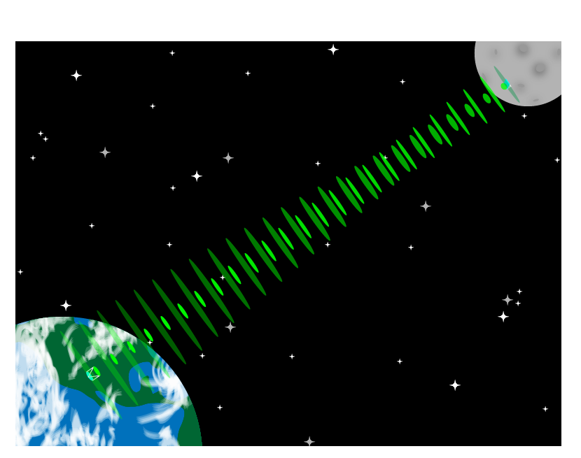
APOLLO sends 20 pulses per second on a 2.5 second round-trip journey
300,000,000,000,000,000 photons are launched in each pulse…
…only one will return…
…if we’re lucky

Slide 3
Big Bang Theory: Making it Look Easy

Slide 4
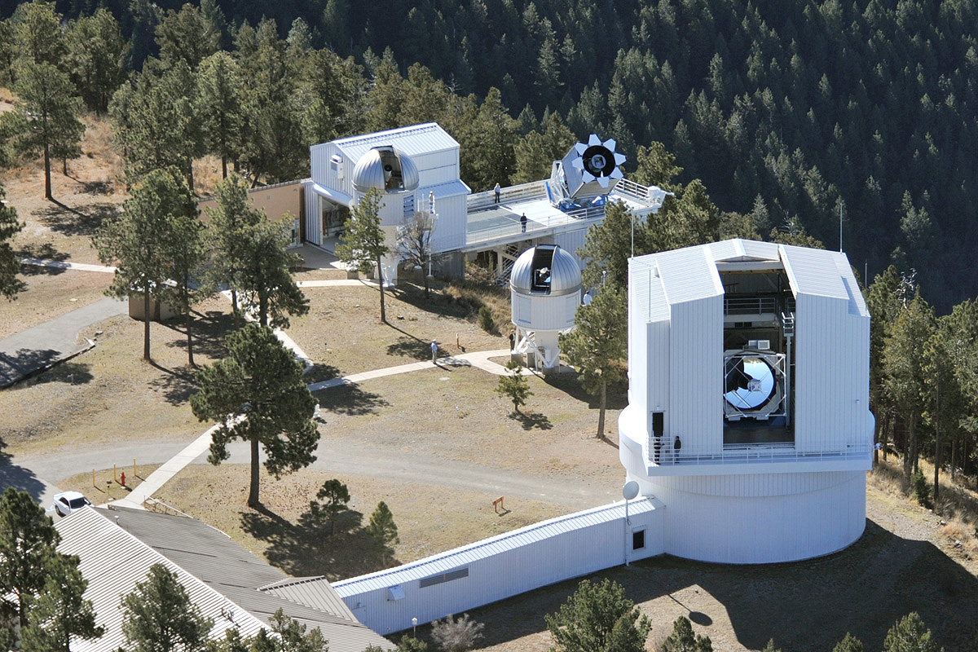
The Earth End
Laser
flexibly scheduled, high-performance, 3.5 meter telescope

Slide 5
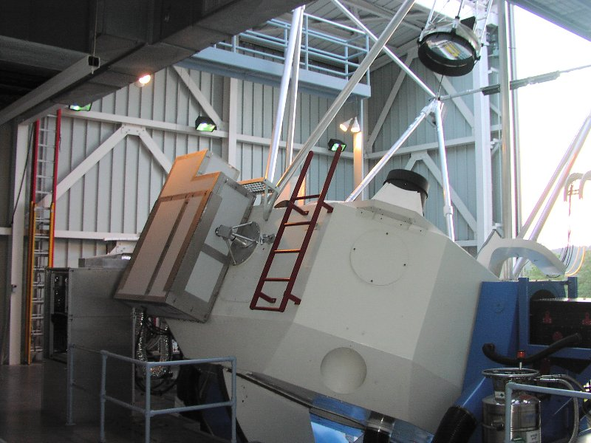
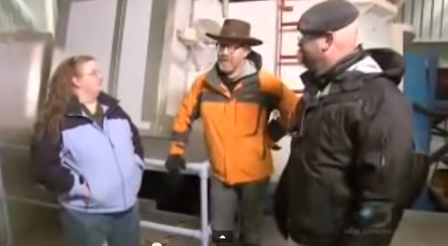
Laser Mounted on Telescope

Slide 6
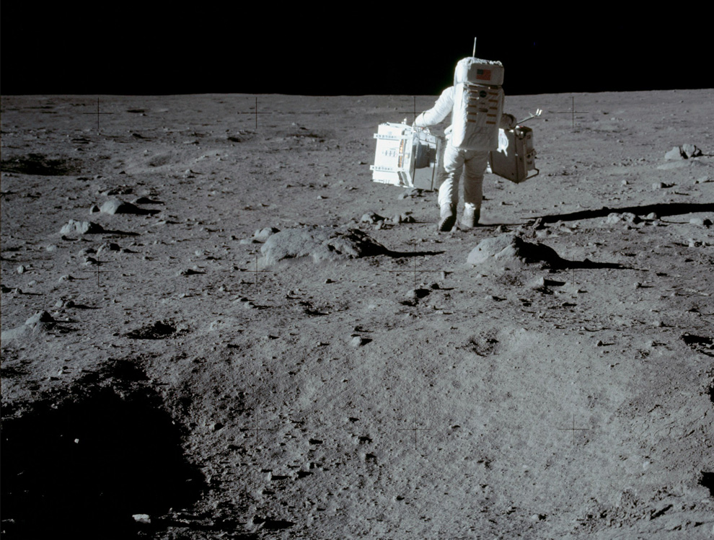
The Lunar End; back when Buzz Aldrin worked for FedEx
reflector array

Slide 7
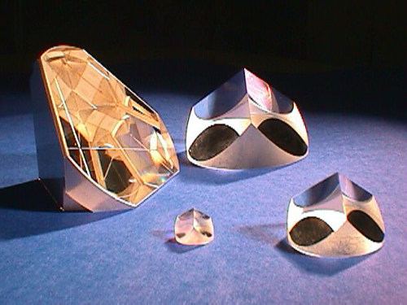
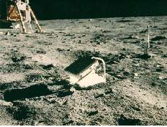
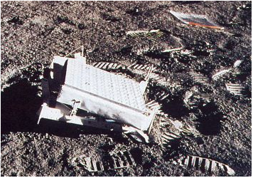
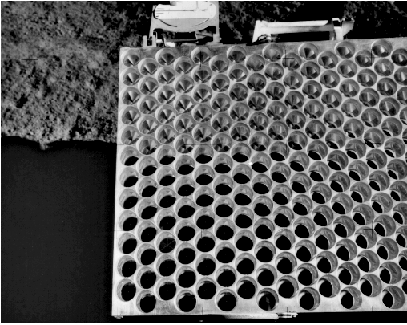
Lunar Reflectors
Corner cubes
Apollo 11 retroreflector array
Apollo 14 retroreflector array
Apollo 15 retroreflector array

Slide 8
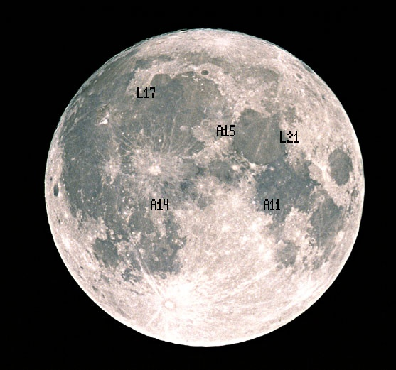
Reflector Positions
The Apollo missions left:
  Apollo 11: 100 corner cubes
  Apollo 14: 100 corner cubes
  Apollo 15: 300 corner cubes
The Soviets landed:
  Luna 17; Lunokhod 1 rover
  Luna 21; Lunokhod 2 rover
  each with 14-cube array, comparable in response to Apollo arrays

Slide 9
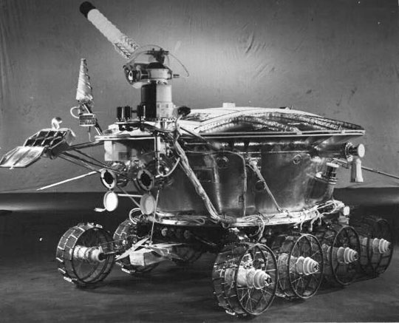
Lunokhod Rover
reflector

Slide 10
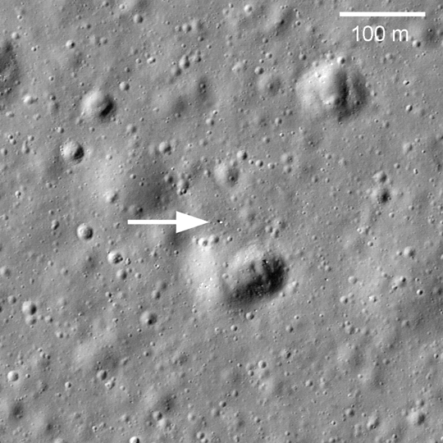
Lunokhod 1 was lost for 40 years…
…then imaged by the Lunar Reconnaissance Orbiter (LRO)…
…then the reflector signal recovered by APOLLO
Your discovery gives hope to all of us
who lost something during the seventies…
− Ed Leon
Apache Point Observatory

Slide 11
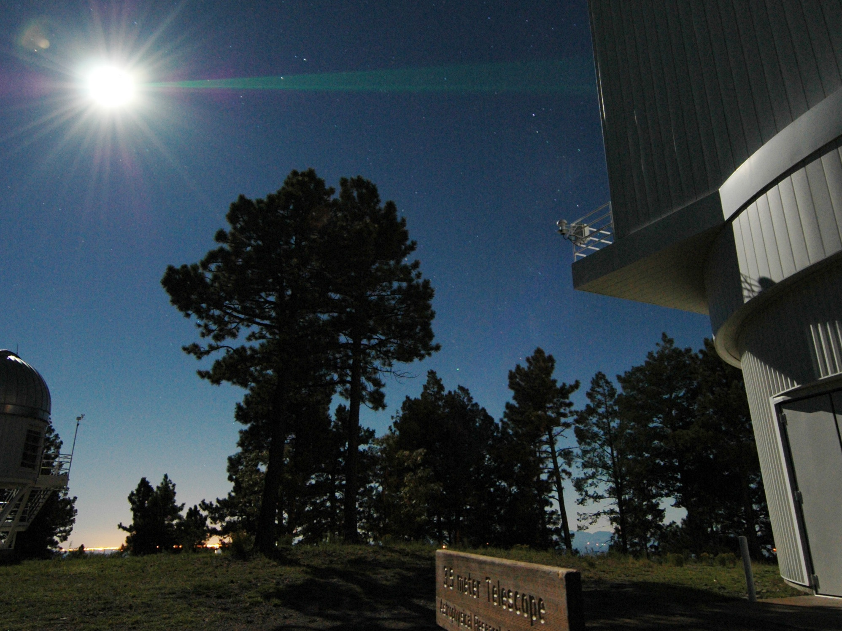
Why do we do this? Besides the fact that it’s cool?
photo: Dan Long

Slide 12
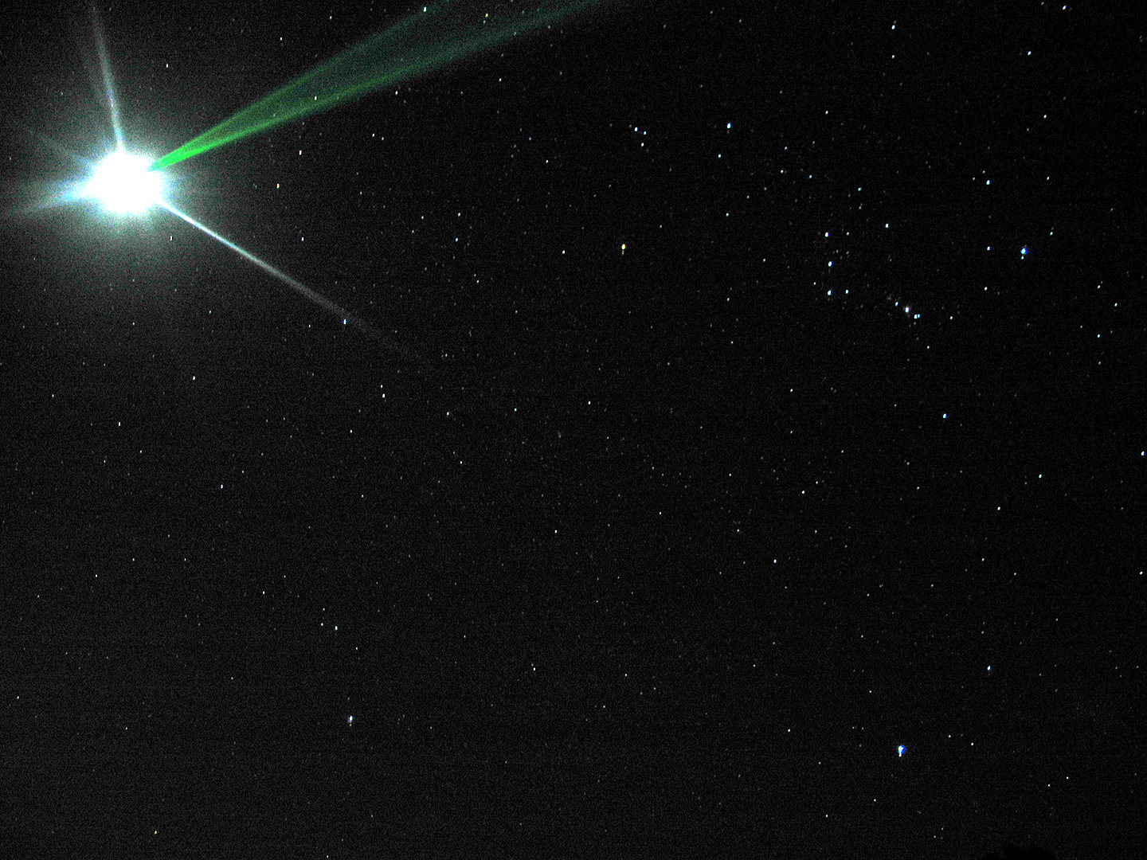
Gravity (described by General Relativity) is fundamentally incompatible with Quantum Mechanics
So the two main pillars of physics don’t get along
photo: Gretchen van Doren

Slide 13
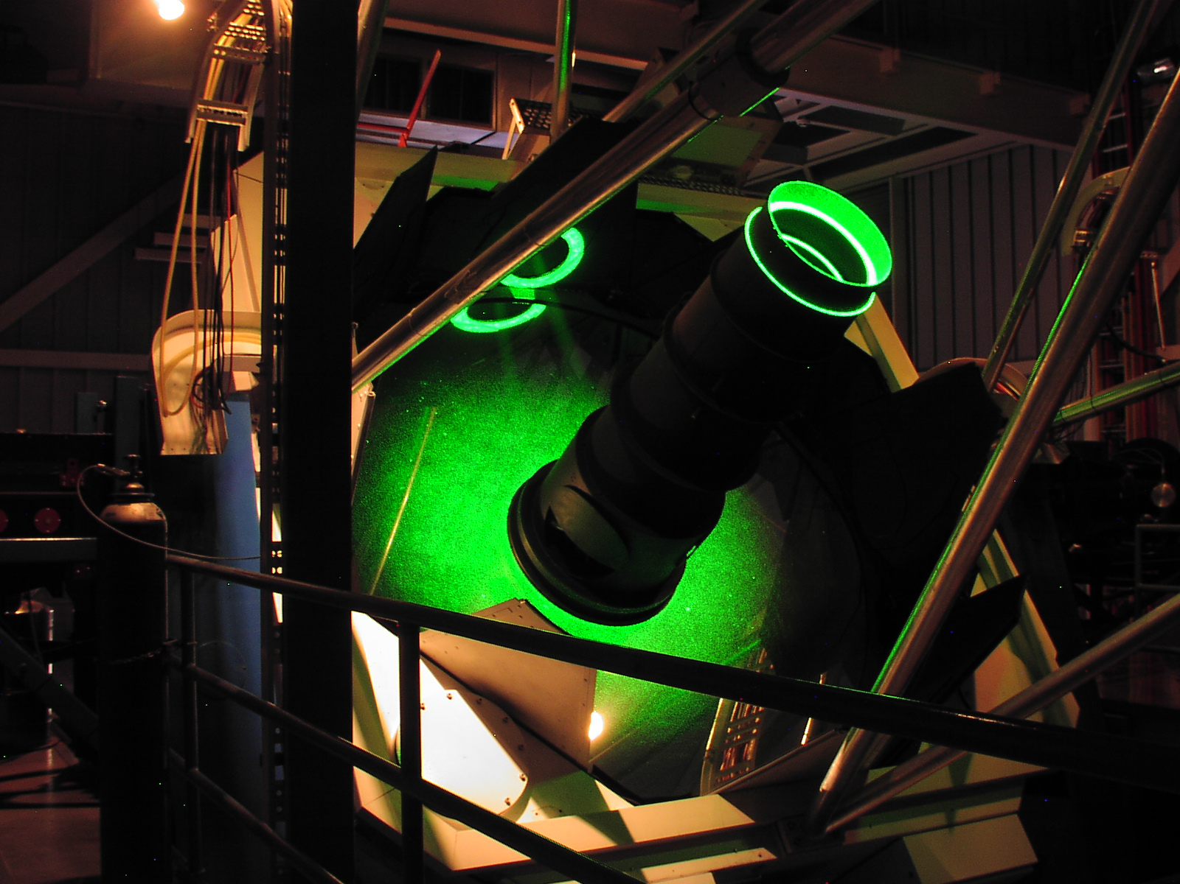
We need to actively test gravity to the highest possible precision, to resolve the conflict

Slide 14
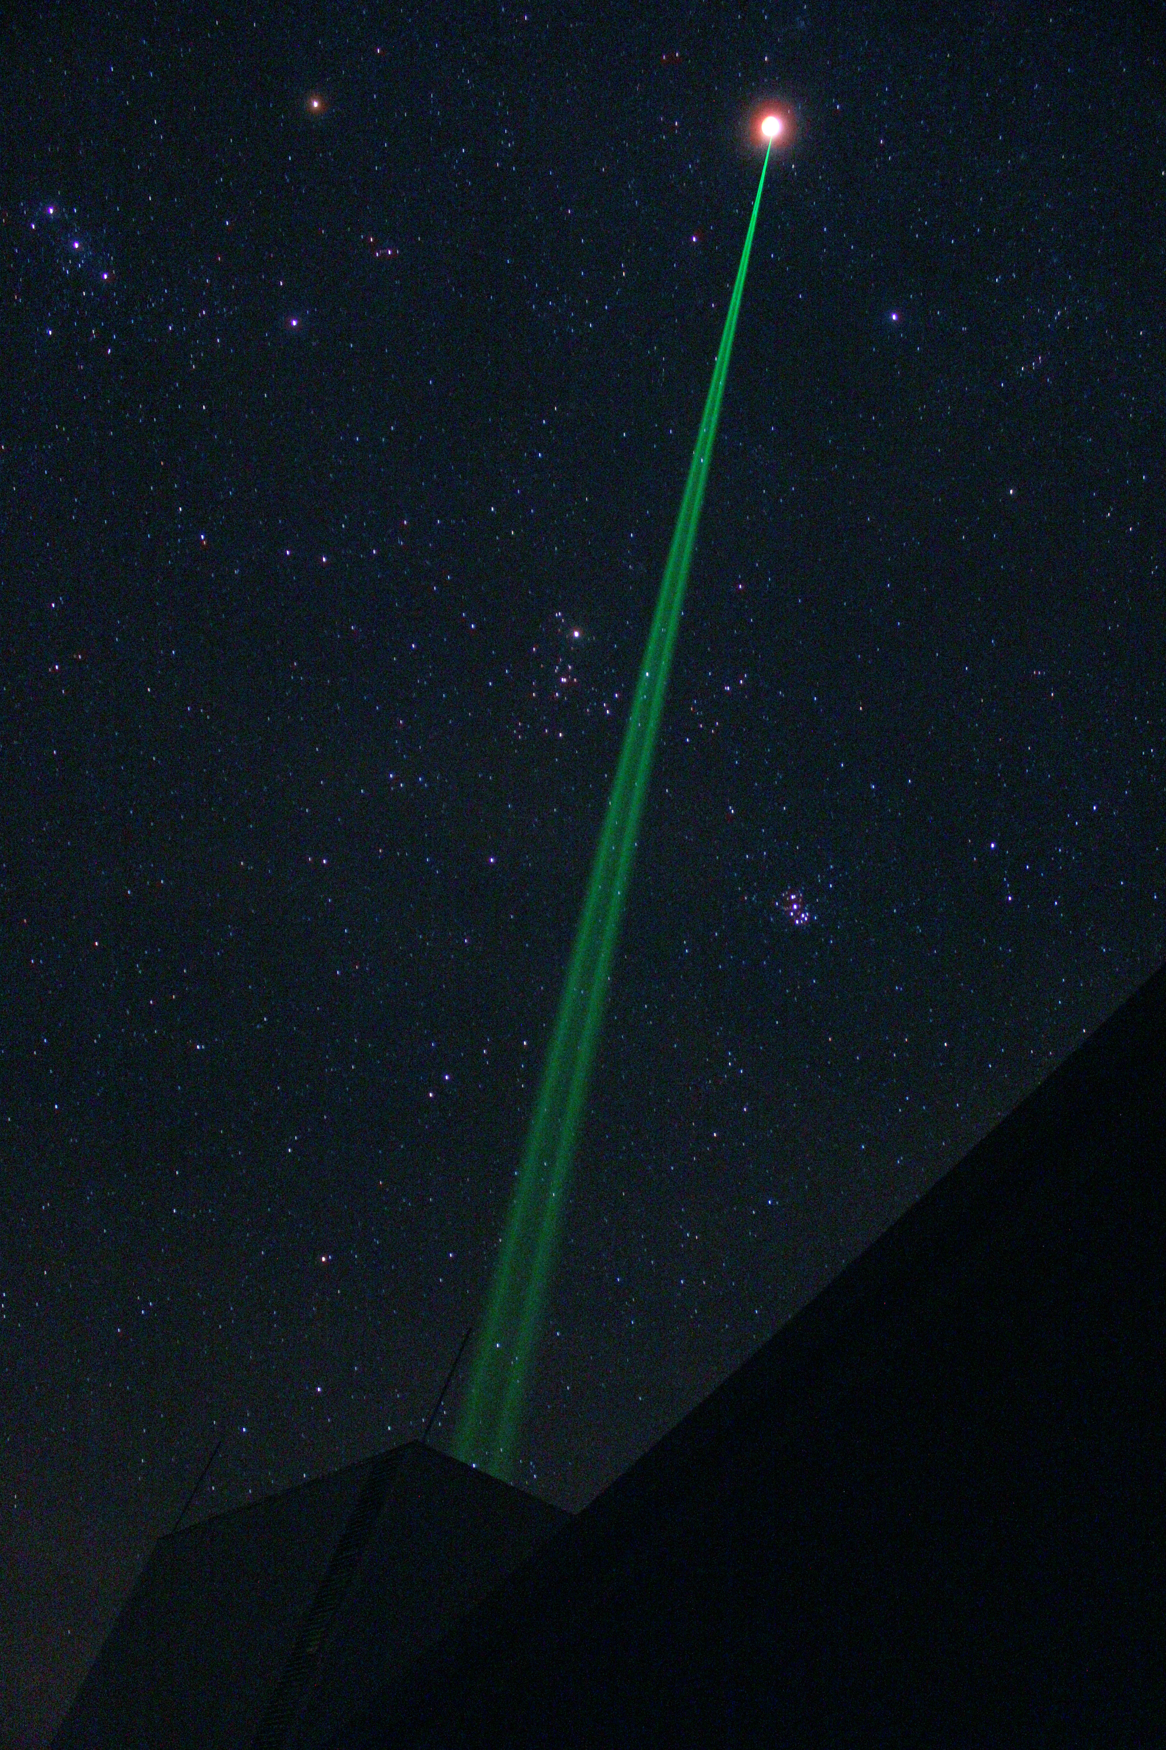
The solar system provides a pristine laboratory
Friction-free; gravity dominates; big test masses
eclipse photo: Jack Dembicky

Slide 15
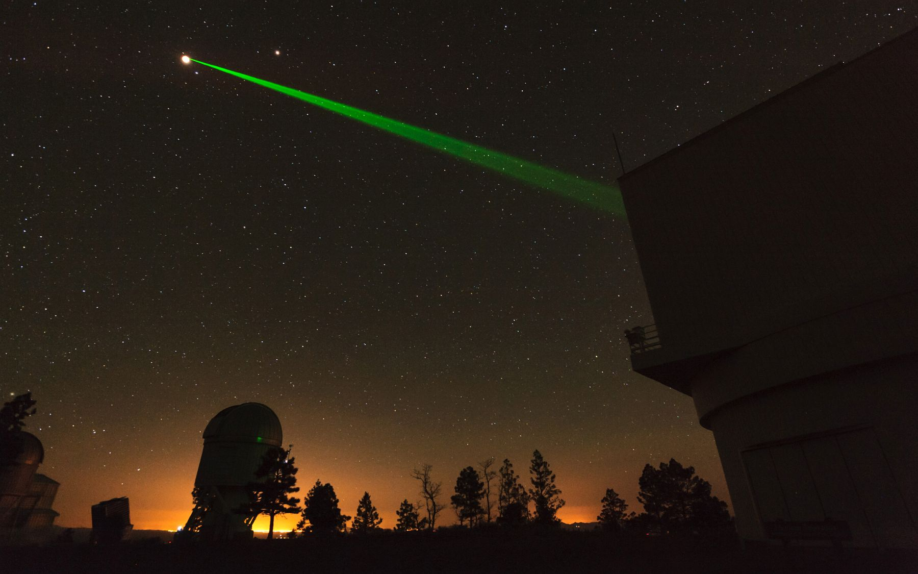
Einstein’s gravity (general relativity) imposes ~10 meter departures of the Moon’s orbit
compared to Newton’s gravity
Testing to millimeter precision answers: was Einstein right?
eclipse photo: Dan Long

Slide 16
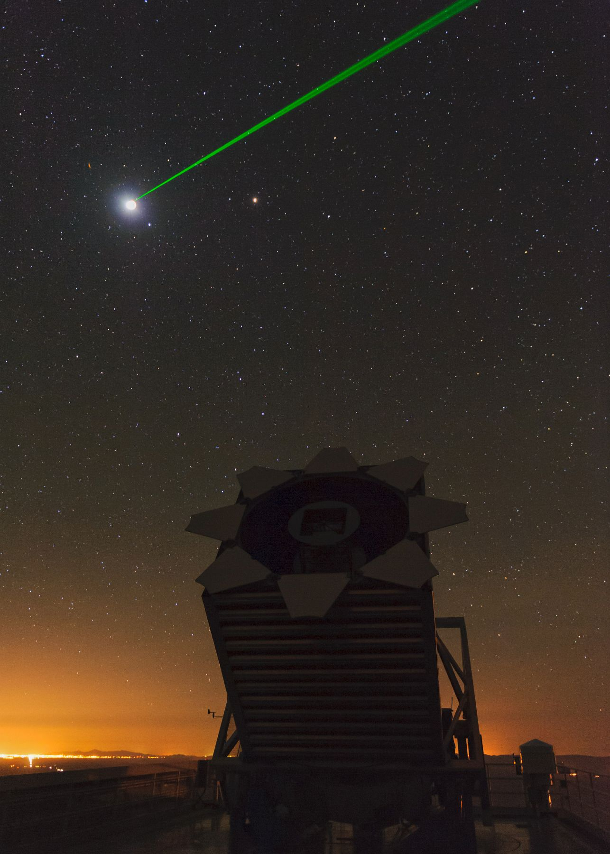
APOLLO is by far the premier lunar ranging facility in the world
Achieve millimeter range precision, challenge to model
In addition to learning about gravity, we:
characterize the Moon’s liquid core
find that the reflectors are half-covered by dust
learn about the Earth’s floppy crust (at mm level)
see the solid Earth rising and falling two feet due to tides
see high-pressure weather systems pushing down on NM
photo: Dan Long

Slide 17
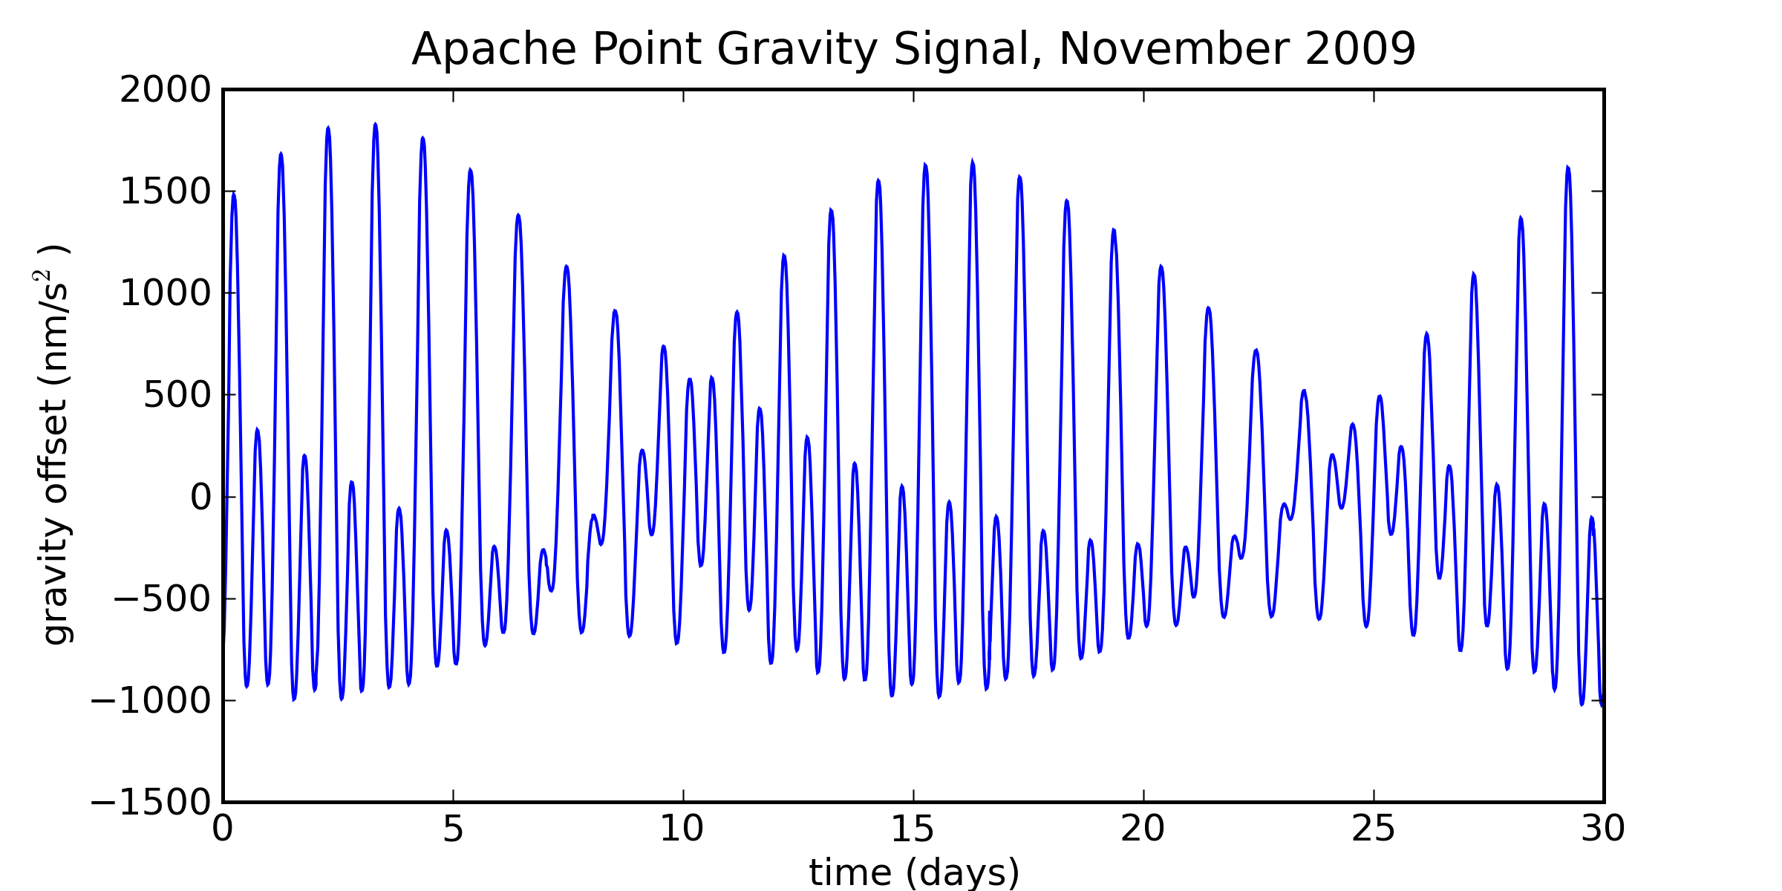
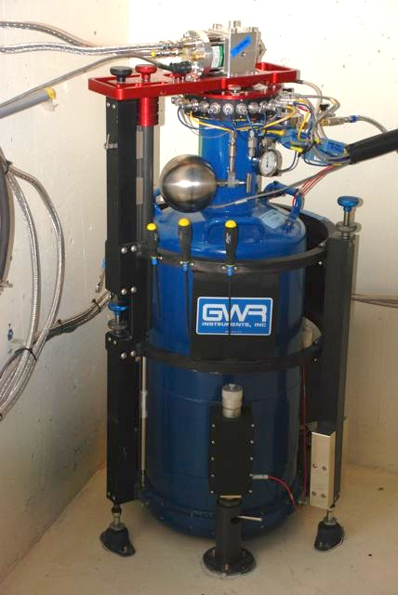
Superconducting Gravimeter Sees All
0.5 m
We care about millimeter displacements of floppy Earth crust
  gravimeter has sub-millimeter height sensitivity
Helps us characterize tides, measure loading of crust
  fight gravity with gravity!
Notes:
17

Slide 18
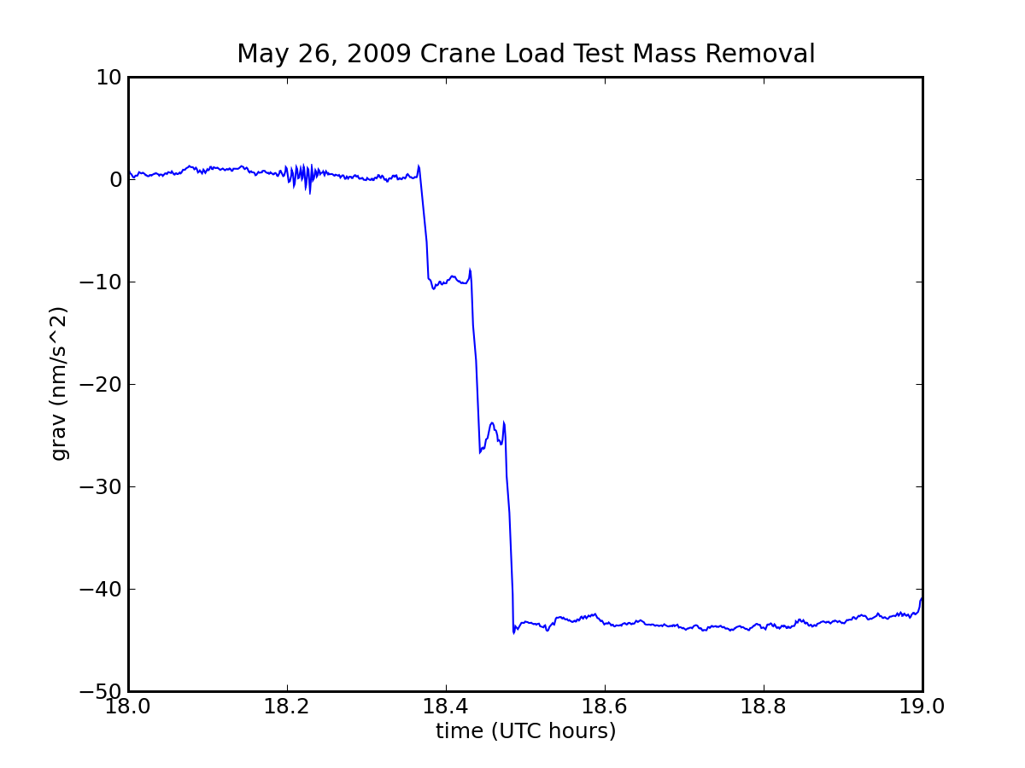
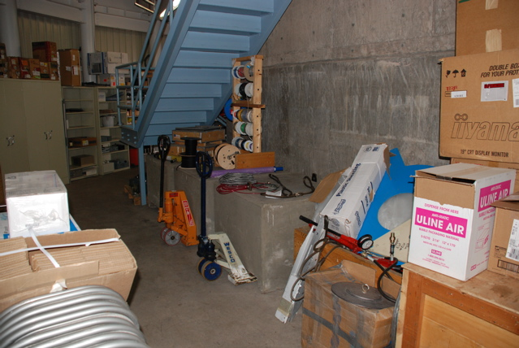
Fun with Gravimetry
One day saw three steps in gravity record
  unequal, within 10 minutes
Turns out to have been giant concrete blocks used to load-test the observatory crane being moved away
  can tell which was moved first, second, third
Also see telescope dome rotation as up to 5 nm/s² offset
See Earth ringing for a month after Chilean earthquake Feb. 2010 and Sendai in March 2011
  20 minute period “breathing” mode
Notes:
18

Slide 19
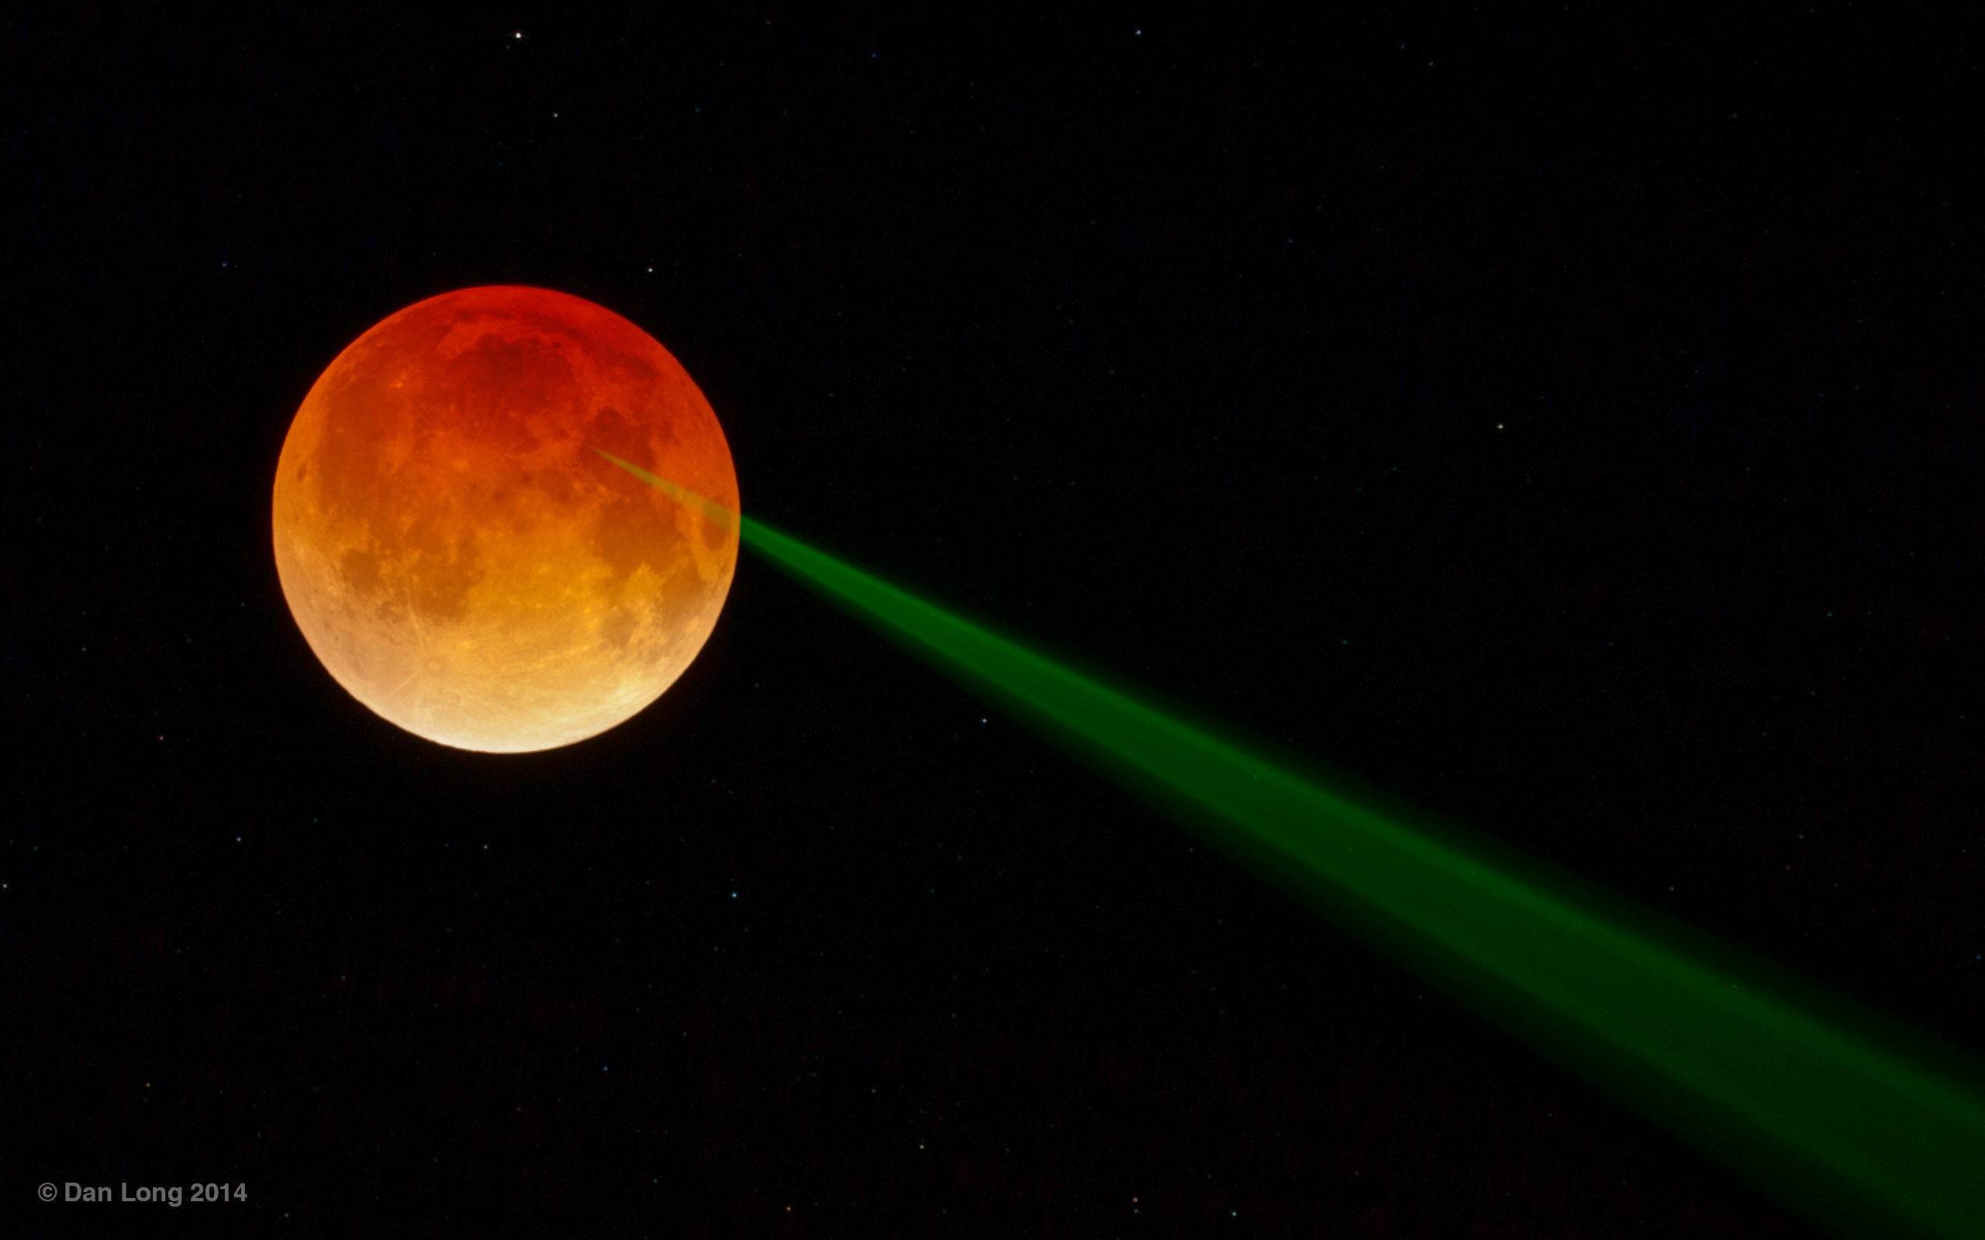
2014.04.15 Eclipse: Test Reflector Health
Astronomy Picture of the Day, 2014.04.18: Dan Long

